Slide 1
Crystal Quantum Shield (C.Q.S.)
Quantum-Enhanced Cybersecurity for the Next Generation of Data Protection

Slide 2



Team Members
Ayush Verma Aakarshit Srivastava Bhaskar Banerjee
Fullstack Developer Machine Learning Developer Backend Developer

Slide 3
Problem Statement
In the rapidly evolving digital landscape, organizations are increasingly dependent on cloud environments and distributed networks for managing and exchanging sensitive data. However, traditional cybersecurity measures are struggling to keep pace with advanced cyber threats and the potential impact of quantum computing, which threatens to undermine existing encryption methods. This creates a significant vulnerability across various aspects of data security.
A key area of concern is the security of APIs, which are essential for modern applications and facilitate data integration and communication between systems. APIs are particularly vulnerable to several key problems:
Advanced Persistent Threats: Attackers can exploit vulnerabilities in APIs to gain unauthorized access and persistently compromise data.
Insufficient Authentication and Authorization: Weak or improperly implemented authentication and authorization mechanisms can allow unauthorized users to access sensitive information.
Rising Malicious API Calls: A 348% increase in malicious API calls highlights the growing threat.
Data Exposure: APIs can inadvertently expose sensitive data through misconfigured endpoints or inadequate access controls.
Injection Attacks: APIs can be susceptible to injection attacks, where malicious inputs exploit vulnerabilities to execute harmful operations.
Security Misconfigurations: Inadequate configuration of API security settings can lead to vulnerabilities and increased risk of attacks.
There is an urgent need for a comprehensive, future-proof cybersecurity solution that addresses these specific challenges in API security while also providing robust protection against general cyber threats and the potential risks posed by quantum computing. Ensuring the integrity, confidentiality, and availability of data in this complex and interconnected environment is critical for maintaining secure and reliable operations.

Slide 4
Proposed Solution
To address the escalating threats and vulnerabilities associated with APIs, we propose the development of Crystal Quantum Shield (CQS), a comprehensive cybersecurity solution integrating cutting-edge quantum cryptography with advanced AI-driven threat detection and real-time monitoring. The solution will leverage CRYSTALS-Kyber and CRYSTALS-Dilithium for robust encryption and authentication, while also incorporating Grafana and Prometheus for effective monitoring and visualization.
Key Features:
Quantum Cryptography:
CRYSTALS-Kyber: Ensures quantum-resistant key exchange and encryption to protect data from future quantum threats.
CRYSTALS-Dilithium: Provides secure digital signatures for verifying data integrity and authenticity.
AI-Driven Threat Detection:
Utilizes advanced machine learning algorithms to detect anomalies, predict vulnerabilities, and respond to threats in real-time.
Enhanced API Security Measures:
NGINX: Implements multi-level reverse proxying, load balancing, rate limiting, and XSS prevention.
Token Scrambling: Enhances security for JWT and OAuth tokens, ensuring robust authentication.
Real-Time Monitoring and Analytics:
Prometheus: Collects and stores metrics on system performance, security events, and threat detection.
Grafana: Offers real-time visualization of metrics and logs through comprehensive dashboards for monitoring and analysis.
Scalable Architecture:
Designed to protect data across distributed networks and cloud environments, with scalability for enterprise applications.

Slide 5
Problems Addressed by C.Q.S.
Authentication Hijacking:
How Solved: CRYSTALS-Kyber and CRYSTALS-Dilithium provide advanced quantum-resistant cryptographic methods for secure key exchange and digital signatures. Token scrambling further enhances the security of JWTs and OAuth tokens, making it significantly harder for attackers to hijack authentication mechanisms.
Injection Attacks:
How Solved: AI-driven threat detection continuously monitors API interactions and system behavior to identify and mitigate injection attack vectors. By analyzing patterns and anomalies in real-time, the solution can detect malicious inputs and prevent them from exploiting vulnerabilities.
Data Exposure:
How Solved: CRYSTALS-Kyber encrypts data to protect it during transfer, while CRYSTALS-Dilithium ensures data integrity through secure digital signatures. Additionally, NGINX configurations for secure reverse proxying and rate limiting help prevent unauthorized access and mitigate data exposure risks.
Rising Malicious API Calls:
How Solved: NGINX implements rate limiting and load balancing to control and distribute incoming traffic effectively. This prevents abuse and overloads, reducing the impact of malicious API calls and maintaining system stability.
Frequent and Sophisticated Attacks:
How Solved: The integration of AI-driven threat detection allows for real-time analysis and response to emerging threats. Prometheus and Grafana provide real-time monitoring and visualization, enabling quick detection and response to sophisticated attack patterns and anomalies.
Inadequate Real-Time Monitoring:
How Solved: Prometheus collects and stores detailed metrics on system performance and security events, while Grafana creates comprehensive dashboards to visualize these metrics. This real-time visibility allows for proactive management of system health and security, quickly identifying and addressing issues before they escalate.

Slide 6
Relation to the Theme: Exploring Future Frontiers
Our proposed solution, Crystal Quantum Shield (CQS), aligns with the theme of exploring future frontiers by addressing the transformative potential of quantum technologies in cybersecurity. This project is specifically tailored to harness the power of emerging technologies like quantum computing to enhance data security, a critical area as we advance into the next era of digital interaction and productivity.
Integration of Quantum Computing:
Quantum Cryptography: CQS incorporates CRYSTALS-Kyber and CRYSTALS-Dilithium, leveraging quantum-resistant algorithms for key exchange, encryption, and digital signatures. This approach ensures that our solution is not only secure against current threats but also resilient to the future advancements in quantum computing. By utilizing quantum cryptographic methods, CQS is a practical application of quantum computing research, transforming theoretical concepts into real-world solutions.
Scalable Security Framework:
AI-Driven Threat Detection and Real-Time Monitoring: The use of AI and real-time monitoring tools like Prometheus and Grafana complements the quantum cryptography elements by enhancing our ability to detect and respond to threats dynamically. This integration represents a strategic adjustment necessary to scale cybersecurity measures to meet the challenges posed by advanced technologies and evolving cyber threats.
Transformative Impact:
Scalable Architecture: Designed with scalability in mind, CQS addresses the need for adaptable security solutions that can evolve alongside technological advancements. Its architecture is built to protect data across distributed networks and cloud environments, making it suitable for large-scale applications in various industries.
By incorporating quantum computing principles into a scalable security framework, CQS exemplifies how emerging technologies can be effectively applied to address current and future challenges, ensuring that our digital infrastructures remain secure and resilient as we move towards a more advanced technological era.

Slide 7
Need for Crystal Quantum Shield (C.Q.S.)
Increasing Cyber Threats:
Rising Attacks: With a 348% increase in malicious API calls, advanced security measures are critical. CQS addresses this by using quantum- resistant cryptography (CRYSTALS-Kyber and CRYSTALS-Dilithium) and AI-driven threat detection to counter sophisticated attacks.
Quantum Computing Threats:
Future-Proofing: As quantum computing advances, traditional cryptographic methods may become vulnerable. CQS’s use of quantum- resistant algorithms ensures data security against future threats.
OWASP Top 10 API Security Risks:
Broken Object Level Authorization: CRYSTALS-Kyber enhances data access protection through robust cryptographic methods.
Broken User Authentication: Token scrambling strengthens JWT and OAuth security, mitigating authentication risks.
Excessive Data Exposure: CRYSTALS-Dilithium encrypts data and ensures integrity, reducing unauthorized exposure risks.
Lack of Resource & Rate Limiting: NGINX’s rate limiting and load balancing prevent abuse and manage traffic effectively.
Security Misconfiguration: Prometheus and Grafana monitor and detect security gaps promptly.
Insecure Defaults & Inadequate Encryption: Advanced encryption standards ensure secure default configurations.
Broken Function Level Authorization: AI-driven threat detection identifies and addresses unauthorized access attempts.
Demand for Enhanced Security:
Regulatory Compliance: CQS helps meet stringent data protection laws and regulatory requirements.
Business Continuity: Provides critical protection for high-stakes industries to maintain operational integrity.
Real-Time Threat Management:
Operational Efficiency: Prometheus and Grafana offer real-time monitoring and analytics for timely threat detection and response.

Slide 8
Does the product or solution you are building have any competitors?
Yes, while there are established players like Cloudflare, Astra Security, and Postman in the cybersecurity and API management space, the Crystal Quantum Shield (CQS) introduces a pioneering approach with distinct advantages:
Cloudflare: Strengths: Strong in DDoS protection, SSL encryption, and web application firewalls.
Limitations: Lacks post-quantum cryptography and AI-driven threat detection, which CQS provides.
Astra Security: Strengths: Effective in vulnerability scanning and malware removal.
Limitations: Focuses on web security without quantum-resistant measures and AI capabilities, unlike CQS.
Postman: Strengths: Popular for API development and testing.
Limitations: Lacks specialized API security features that CQS offers, such as quantum-resistant encryption.
CQS Differentiators:
Quantum-Resistant Cryptography: CRYSTALS-Kyber and CRYSTALS-Dilithium.
AI-Driven Threat Detection: Real-time identification and mitigation of threats.
Real-Time Monitoring & Analytics: Comprehensive security oversight with Prometheus and Grafana.
Conclusion: While these competitors are strong in their domains, CQS’s quantum-resistant and AI-driven approach makes it a future-proof, innovative solution.

Slide 9
Technologies and Security Framework
Security Workflow:
API Gateway: Manages API requests, including login, search, and payments.
Multi-Layer Proxy Servers: Employs NGINX for reverse proxying, filtering, token scrambling, and managing secure data flow.
Endpoint Monitoring: Continuously monitors endpoints to detect anomalies and threats in real-time.
Logs and Visualization: Collects API interaction logs and applies deep learning (TensorFlow or PyTorch) for monitoring and alerts.
Tools and Technologies:
Programming Languages: Python for API development and cryptographic integration.
Reverse Proxy: NGINX for secure data handling and multi-layer proxying.
Monitoring and Visualization: Prometheus for metrics collection, Grafana for real-time visualization and dashboards.
Deep Learning: TensorFlow or PyTorch for anomaly detection and threat alerts.
Authentication: OAuth 2.0 and JWT for secure API authentication.
Containerization and Orchestration: Docker and Kubernetes for managing containerized applications.
Alert System: CloudWatch for real-time alerts and monitoring

Slide 10
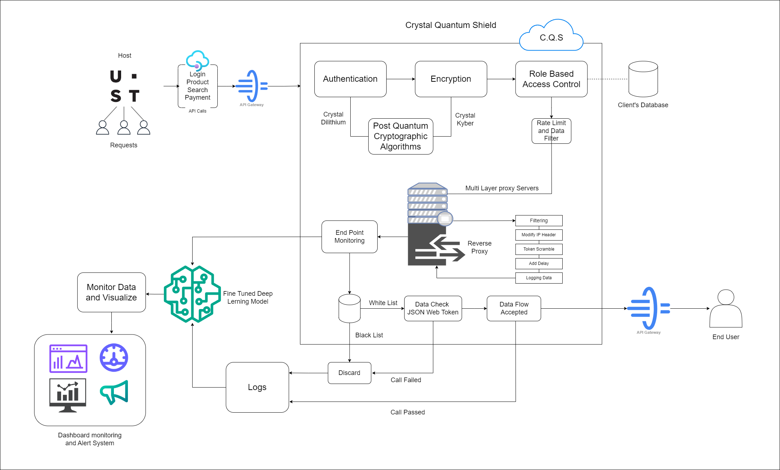
C.Q.S. Architecture

Slide 11
Challenges and Limitations
Integration Complexity:
Description: Integrating CQS with diverse technology stacks and legacy systems presents challenges due to varying compatibility and requirements.
Performance Trade-offs:
Description: Enhancing security measures may impact system performance and latency, requiring a careful balance between security and efficiency.
Scalability Issues:
Description: Ensuring that the solution scales effectively with increasing traffic and user demands is crucial for maintaining performance and reliability.
Resource Constraints:
Description: There is a shortage of skilled personnel with expertise in advanced encryption and secure API design, which can hinder development and implementation.
Security Testing Challenges:
Description: Conducting comprehensive security testing across all API endpoints is complex and may leave gaps if not thoroughly addressed.

Slide 12
Recommendations and Future Work
Continuous Security Enhancements:
Action: Implement automated security testing within a CI/CD pipeline to ensure ongoing identification and remediation of vulnerabilities.
Performance Optimization:
Action: Continuously optimize system configurations to minimize latency while maintaining robust security measures.
Scalability Improvements:
Action: Modularize system components and leverage cloud-native solutions to enable dynamic scalability and efficient resource management.
Enhanced User Training:
Action: Provide regular training to developers and security teams to keep them updated on the latest security practices and techniques.
Expanded Security Coverage:
Action: Broaden security testing to cover real-world scenarios and edge cases, ensuring thorough protection across all potential vulnerabilities.
User Feedback and Iteration:
Action: Establish a feedback loop to gather insights from users and drive iterative improvements to enhance system effectiveness and user experience.
Explore Generative AI:
Action: Investigate the use of generative AI to automate security code generation and improve threat modeling for more adaptive and proactive security measures.

Slide 13
Thank You!

